Slide 1
HEALTH CARE ASSISTANT
DIGITAL SYMBOL OF THE PROFESSION 532102

Slide 2
Health care assistant
Health care assistant is a relatively new medical profession, because it was established in 2008.
It is an auxiliary profession providing caring-nursing activities to sick people in hospital or domestic environment

Slide 3
Health care assistant
The profession of health care assistant is the answer to decreasing number of nurses and an ageing population that requires more care.
Unification of teaching standards is important for the introduction of better quality of care

Slide 4
Health care assistant
A health care assistant is a person who in a fully professional way helps sick and dependent people to satisfy basic necessities of life.
A health care assistant recognizes and solves problems of caring nature in case of sick and dependent people who are in various ages, but also in different stages of advancement of a disease.

Slide 5
Health care assistant
A health care assistant assists health professionals during all care routines, during which he has an auxiliary function, but also supports a dependent and sick person. Providing basic services within health care over a sick and dependent person he undertakes a comprehensive cooperation with a therapeutic and caring team.

Slide 6
Health care assistant
Education leading to this profession can take place in two ways. The first is postsecondary school education, which lasts for one year, the second is education through vocational qualifying course.

Slide 7
Health care assistant
At our school the education for health care assistant lasts for one year and ends with professional examination and receiving the diploma confirming professional qualifications. This diploma allows students to take up employment in the entire European Union.

Slide 8
Health care assistant education
Theoretical learning – (classes are completed at school) – it covers general profession thematic sections and sections that are characteristic and specific only for the profession of health care assistant
Practical training – completed in professional practical training facilities; hospitals, social assistance houses, health care centres

Slide 9
Health care assistant education
The classes are conducted by qualified body of teachers at school; in specialistic laboratories, such as:
Anatomical laboratory
Hygienic procedures laboratory
Emergency medicine laboratory

Slide 10
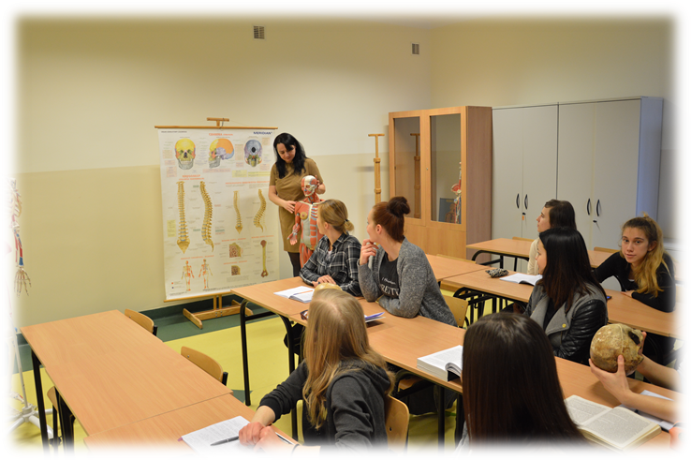
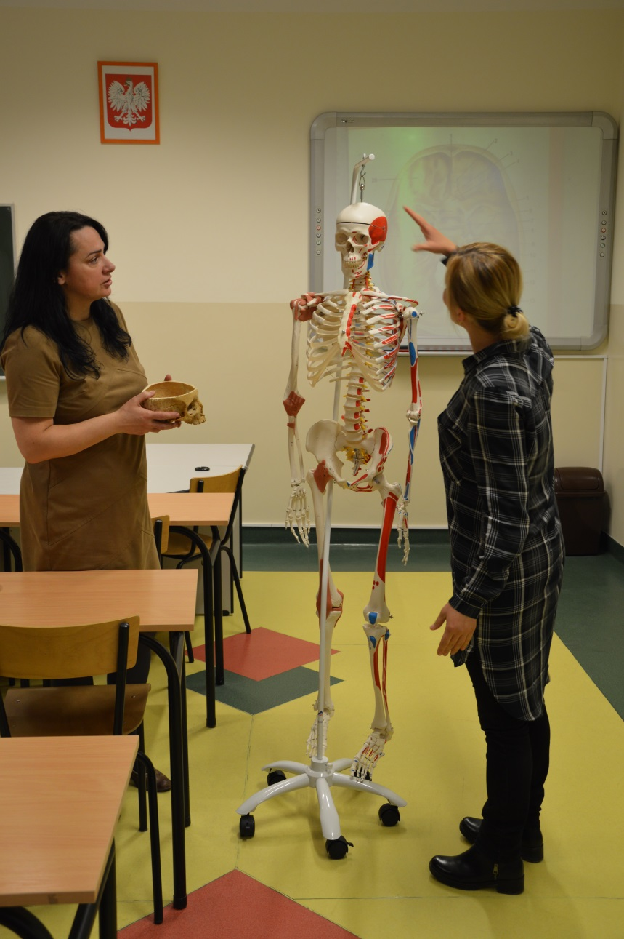
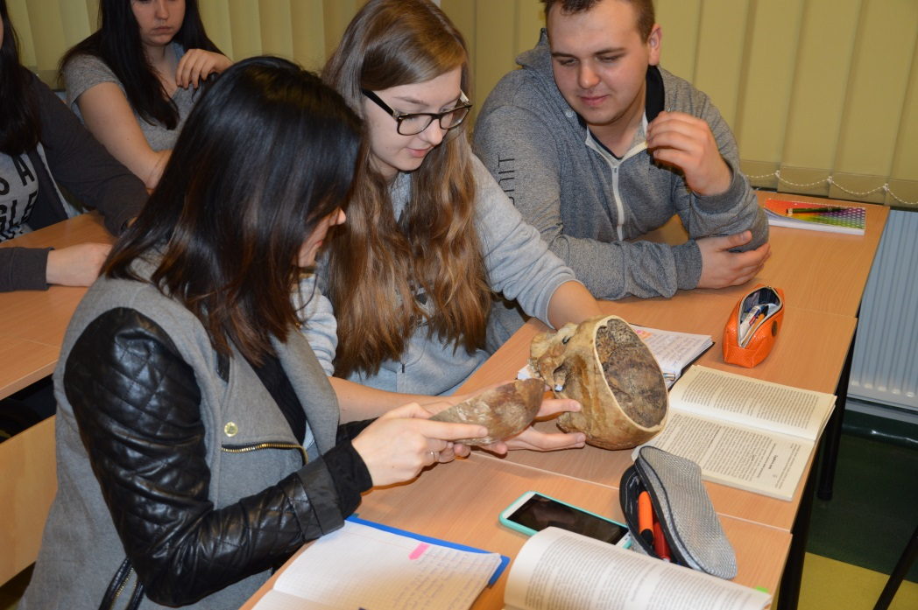
Anatomical laboratory

Slide 11
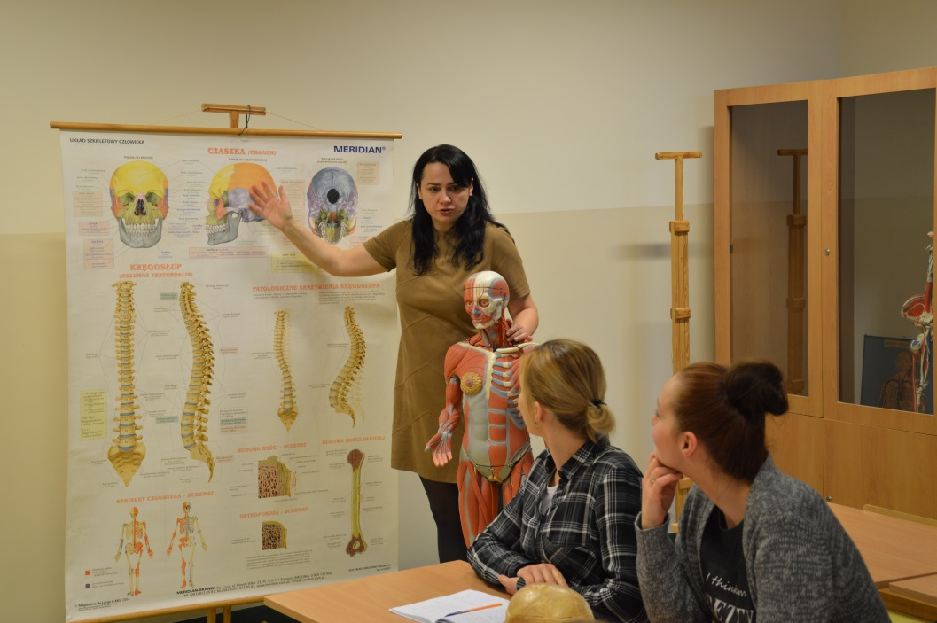
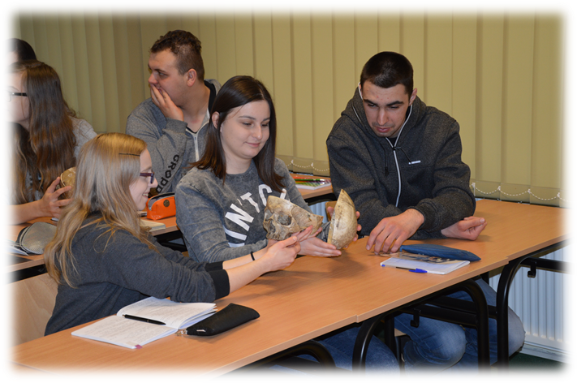
Anatomical laboratory

Slide 12
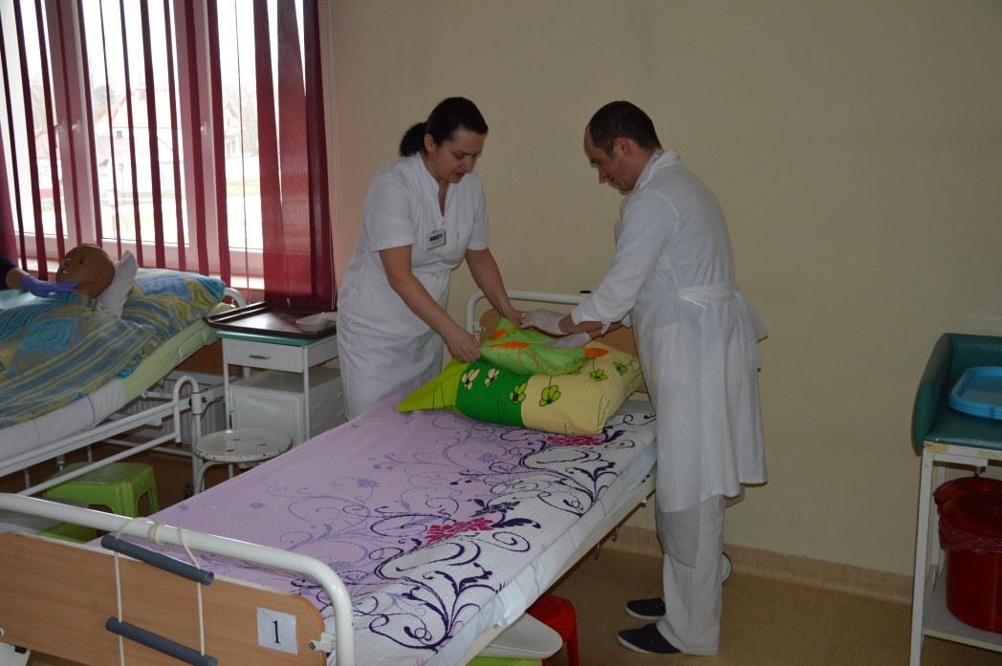
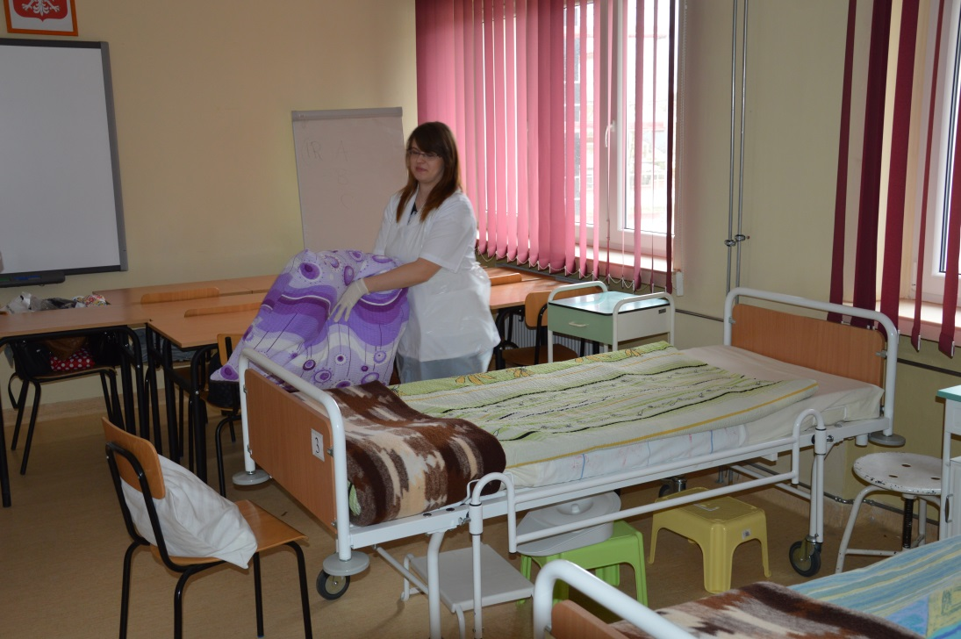
Hygienic procedures laboratory

Slide 13
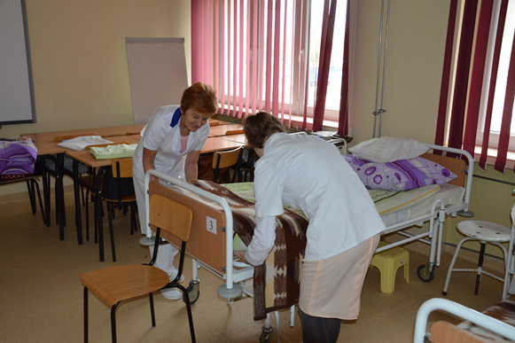
Hygienic procedures laboratory

Slide 14
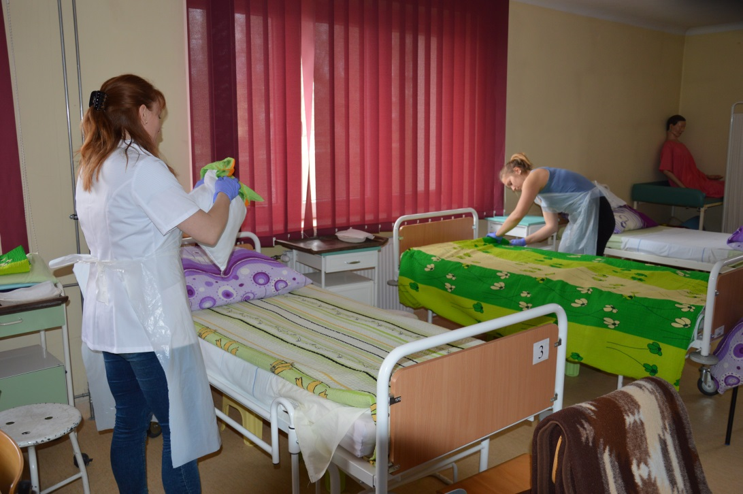
Hygienic procedures laboratory

Slide 15
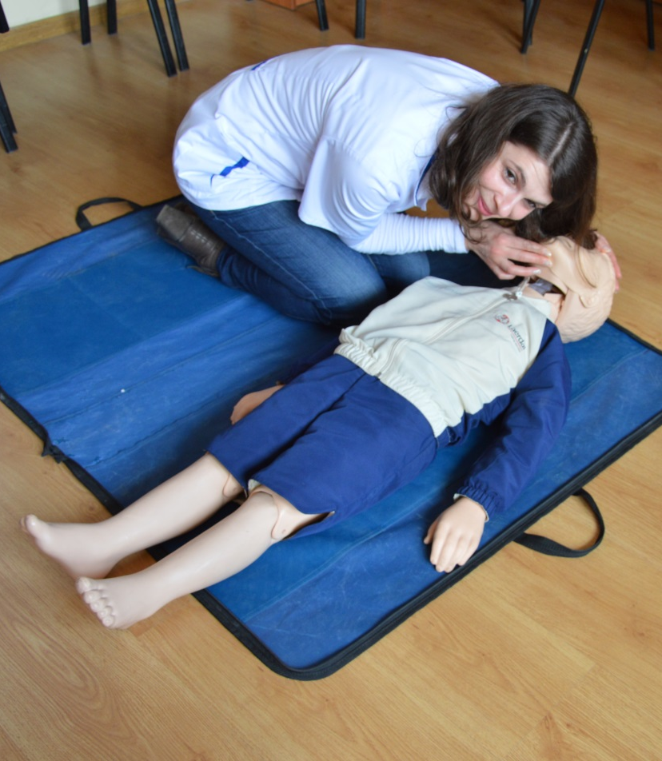
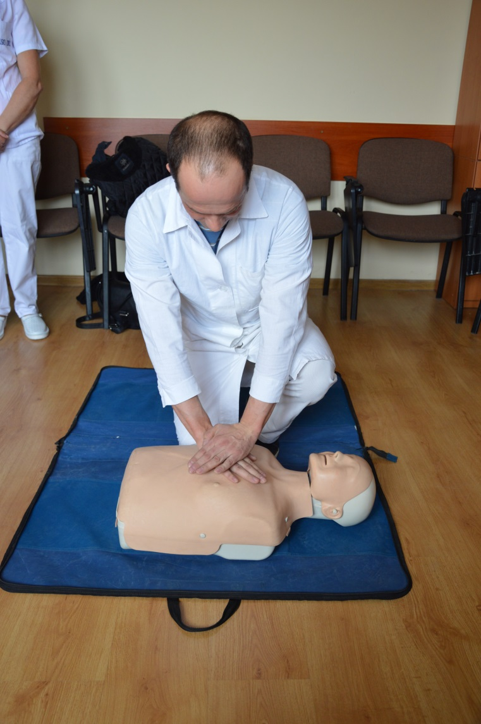
Emergency medicine laboratory

Slide 16
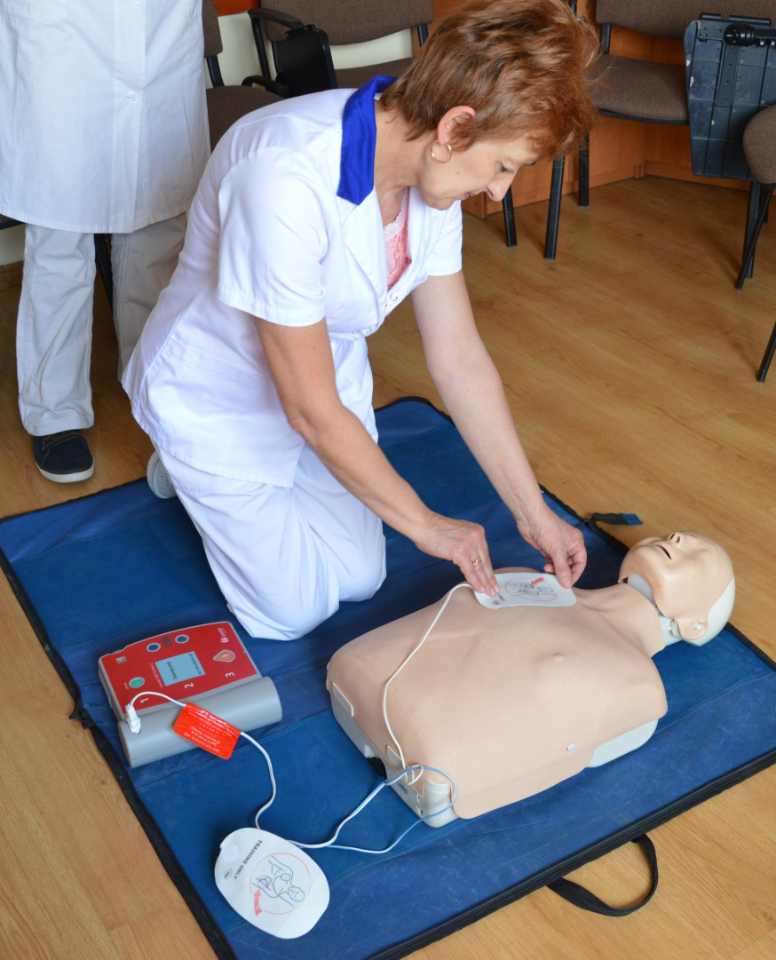
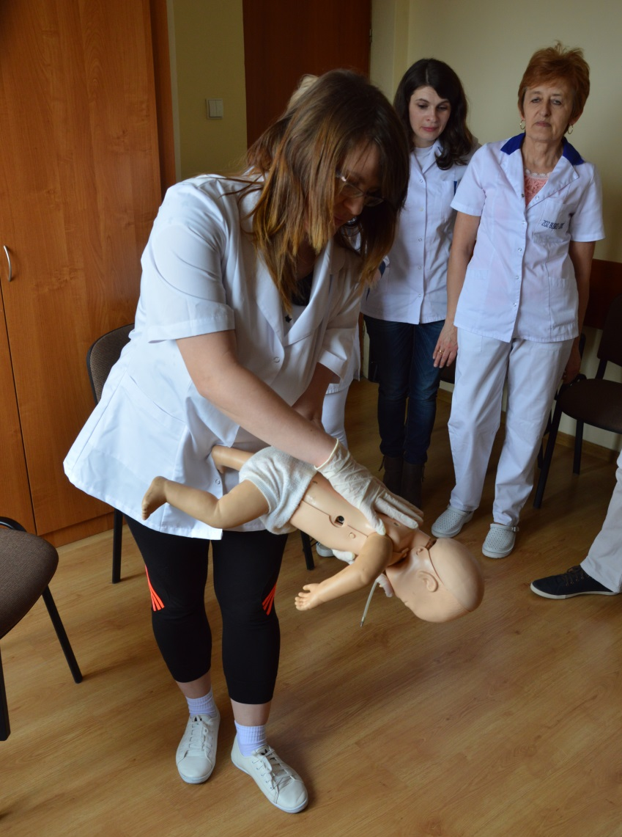
Emergency medicine laboratory

Slide 17
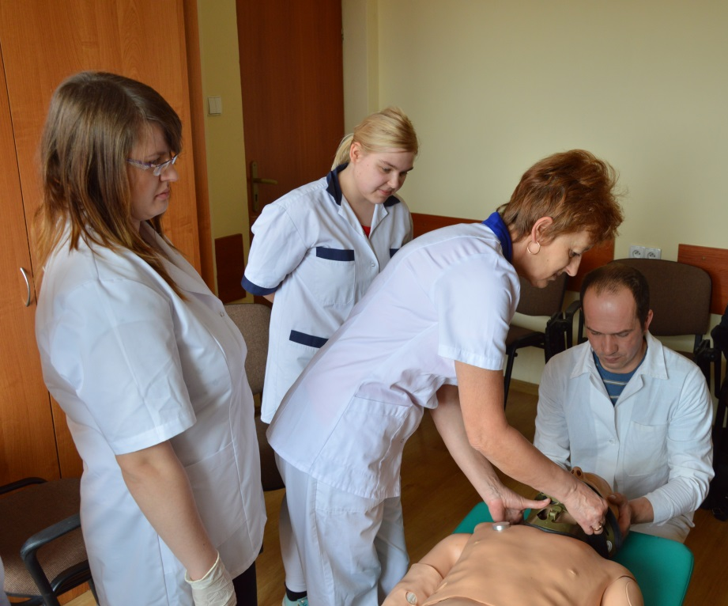
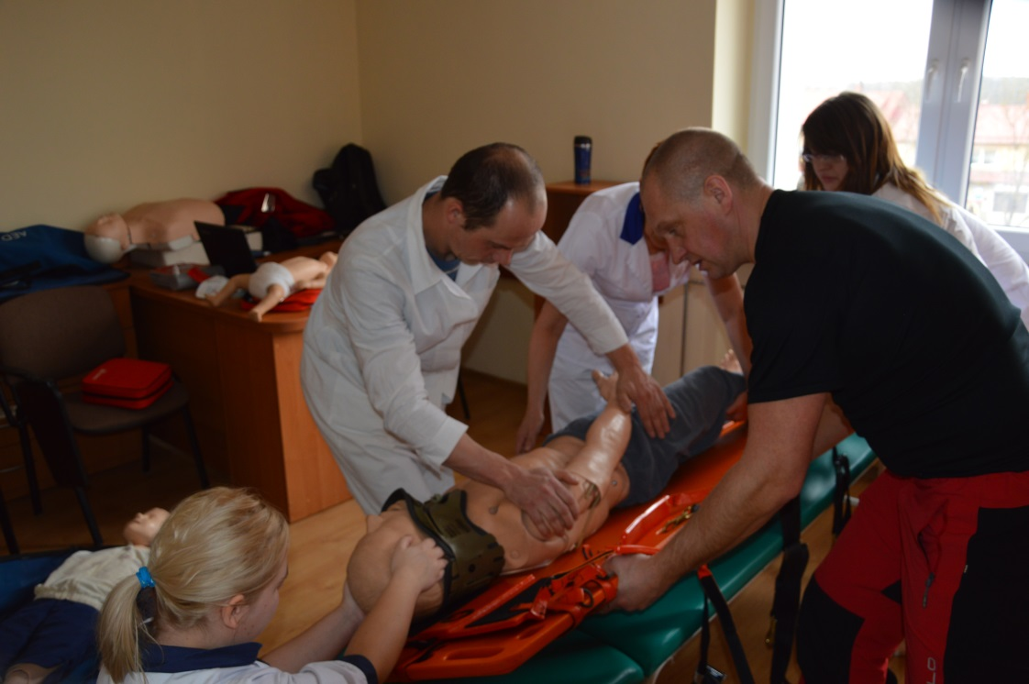
Emergency medicine laboratory

Slide 18
Health care assistant
Employment opportunities for health care assistant:
hospitals - wards
health care centres
social assistance houses and centres
non-public health care teams
individual care at a patient’s home
community assistance houses
foundations and associations acting on behalf of sick and disabled people

Slide 19
Summary
Health care assistant is a person who in a professional way helps a sick and dependent person to satisfy his or her basic necessities of life. Assisting health professionals during care routines, he aids that personnel and at the same time he supports a sick and dependent person.

Slide 20
Summary
Health care assistant is a profession of public trust, therefore it is essential that he has personal and social competencies. Such person should have very good communication skills, ability to work in a team and empathy, which is so important in contact with other person.

Slide 21
Thank you for attention

